Slide 1
CMA CGM GROUP LOGISTICS DIVISION
Implementation & Solutions Department
PARIS CENTER – REGIONAL COMITEE
MARCH 2024

Slide 2
PART OF THE CMA CGM GROUP
IMPLEMENTATION & SOLUTIONS DEPT. EUROPE
REGIONAL COMITEE – MARCH 2024

Slide 3
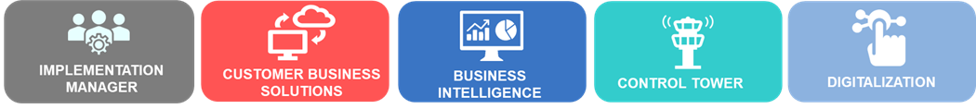
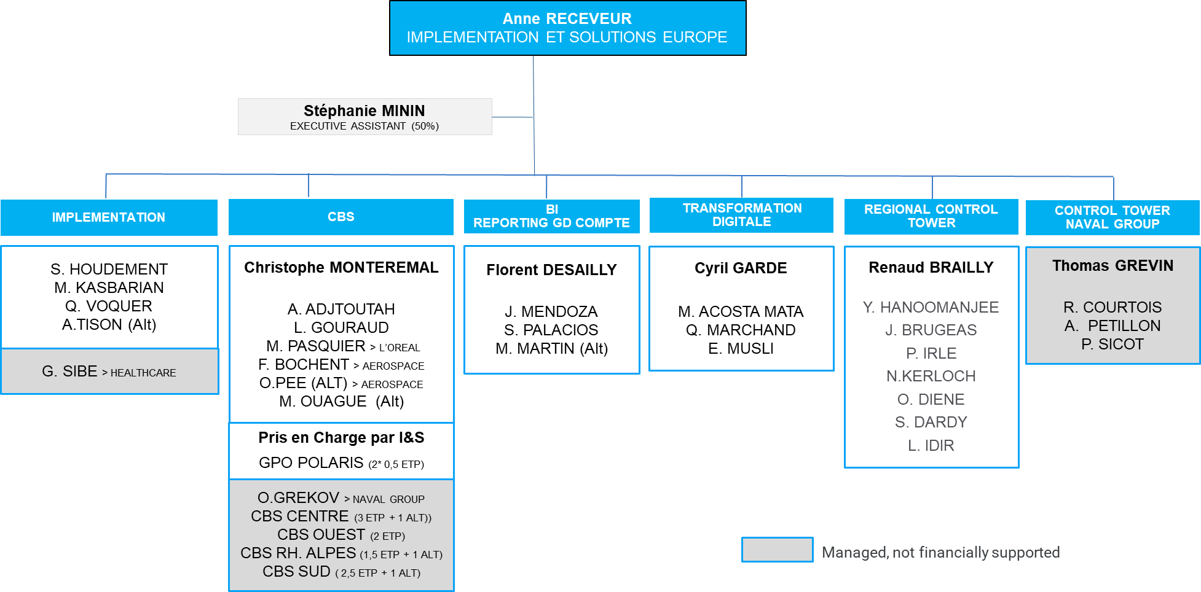

FRONT OFFICE
Notes:
Gap vs Budget : Aero : + 1 Julien Legrand + 0,4 Sandra Franzino / DCM : + 1 Thomas Quintin + 1 Cleo Dapre Alt marketing digital / Outremer : Prolongation JM Dautel / Grand comptes : Attente départ Louisiane Romieu
OPEN SPACE ORGANIZATION
Situation :
+3 FTE (BRS inclusion) ➔ Juniors, closer to Managers
Challenge :
Group and reorganize by stream
Relocate non-I&S people (landfreight : 3 FTE / Airbus Contract mgt : 1 FTE)

Slide 4













IMPLEMENTATION & SOLUTIONS DEPT.
KEY FIGURES
I&S Department Activity 2023
Europe
70%
Global Account
6000
Shipments monitored per month
23
32
16
Bots
Customers Implemented
Requests for
change / evolution
5 Complementary streams
7
Pilots
10
New Cockpits
1250
Reports &
data solutions
10
Countries started
CW1
8000
Reports managed
7
New digital solutions integrated
70+
Permanent staffs in Europe
300+
EDI flows
Notes:
11 CW1 Country started :
France (sea)
Hungary
Portugal
Poland
Ireland
Spain
Czech Republic
Norway
Romania
Belgium
Switzerland

Slide 5





IMPLEMENTATION & SOLUTIONS DEPT.
CUSTOMER BUSINESS SOLUTIONS
IMPLEMENTATION
Global Project Management for startegic account
- New Customers
- New Awards for existing customer
Process reboot & optimization
Main Actions :
Sales Support, Planning Establishment, Project Coordination, Animation, Follow-up
CUSTOMER BUSINESS SOLUTIONS
Experts for IT Customer Solutions
- Project Management
- Sales support
- Business View
- Digital Transformation
Main Actions :
Solution Design, Specs, Test phasis, Training for EDI, Reporting, Track&trace and Web Platforms
BUSINESS INTELLIGENCE
Expertise in data ecosystem
Data governance
Data solutions
Community support
One Cockpit Europe Coordination
Main Actions :
Standard Report Offer, RFE, reports & solutions conception, knowledge sharing
CONTROL TOWER EMEA
Customer dedicated teams
Data Quality & Performance monitoring
Alert & Crisis management
Network animation
Business support
Main Actions :
Communication (SPOC), Monitoring, Improvement at regional Level
DIGITALIZATION
Robotic Process Automation
IDP
New technologies, Apps
New products, platforms (Winddle, P44, Wakeo, …)
Innovation = IA, Real Time Monitoring, predictivity
Main Actions :
Market Watch, Benchmark, Organize & Paricipate to MVP or POC, Promote Solution

Slide 6

CUSTOMER BUSINESS SOLUTIONS
PARIS CENTER ORGANIZATION
Anne RECEVEUR
IMPLEMENTATION ET SOLUTIONS EUROPE
3,5 FTE
Christophe MONTEREMAL
Head of Customer Business Solutions Europe
Marthe HENRY
Christelle JULLIARD
Alexandre BLIN
PUTEAUX
LE MANS
Franck TEUBOU
LE MANS
To contact us :
ml-blx-cbs.pariscenter@bollore.com

Slide 7
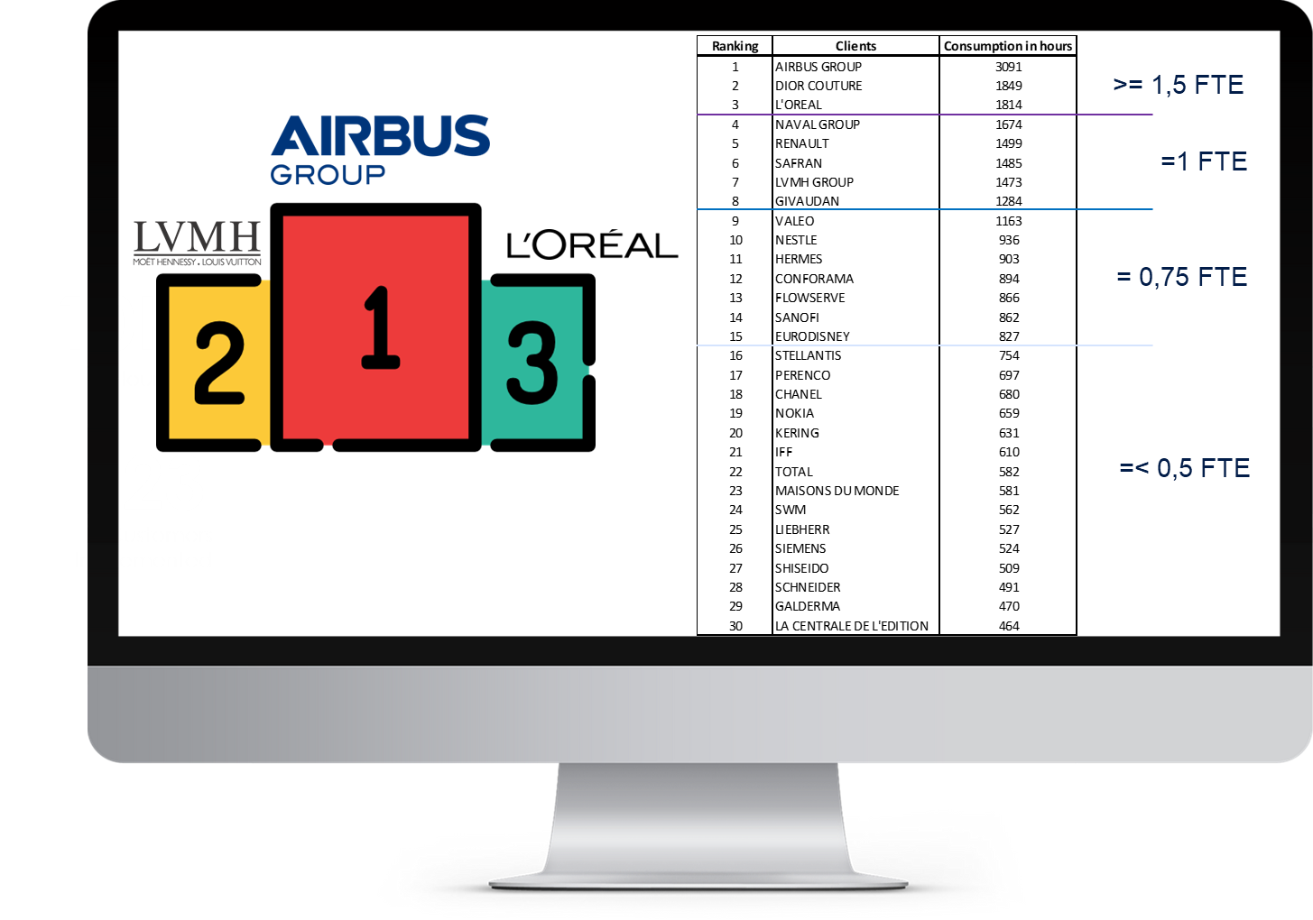




CUSTOMER BUSINESS SOLUTIONS
ACTIVITY OVERVIEW
Jan23
to
Feb24
2023

Slide 8
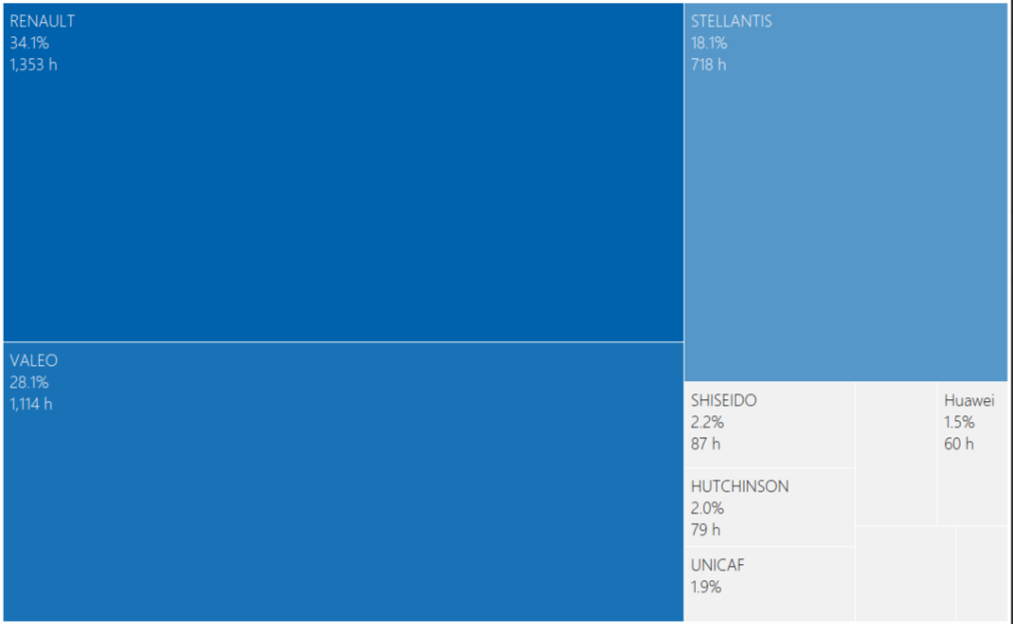
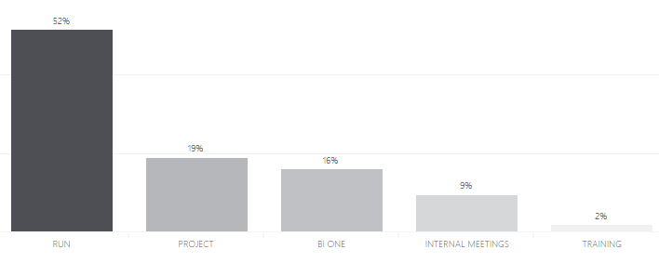
CUSTOMER BUSINESS SOLUTIONS
TOP RANKING
Jan23 to Feb24
Customer ranking by hours
Activity ranking by hours
1,7%
69h
FLOWSERVE
Darty
1,4%
57h
Placo.
0,7%
29h

Slide 9






CUSTOMER BUSINESS SOLUTIONS
CLIENT’S TOP ACHIEVEMENTS FOR 2023
CLIENTS | EDI PROJECT | REPORTING PROJECT | PILOTING PROJECT | KPIs PROJECT | PROCESS OPTIMIZATION | CW1 MIGRATION MDM CLEANING | TENDER PARTICIPATION

Slide 10
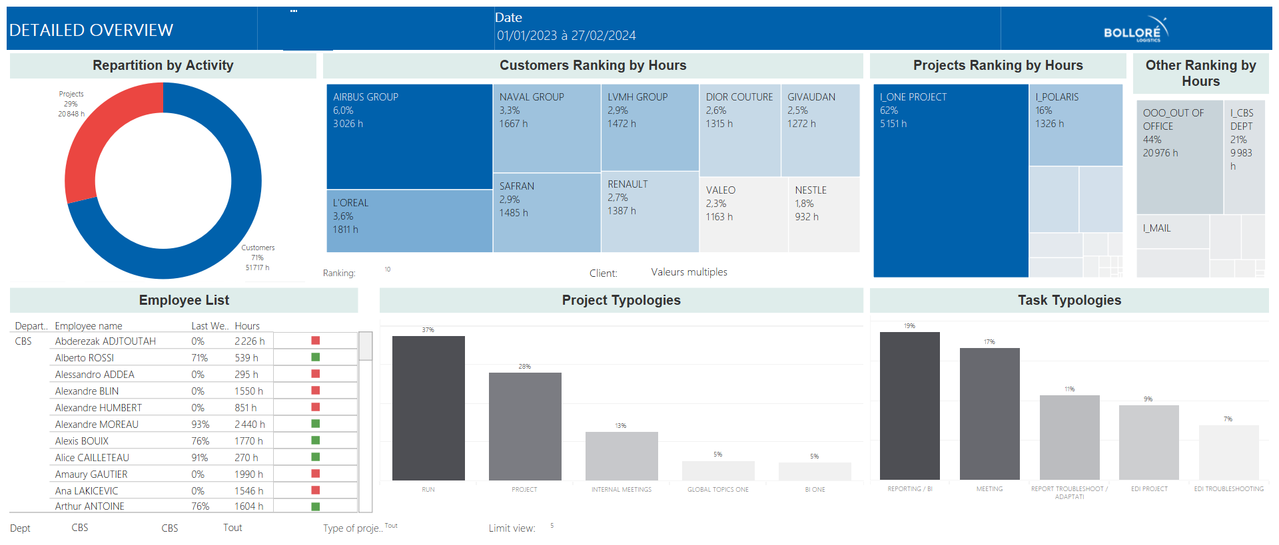






CUSTOMER BUSINESS SOLUTIONS
PILOTING TOOL
FULLY DEPLOYED
CONTINOUS IMPROVEMENT
ROADMAP DEFINITION
STRATEGICAL KPIs

Slide 11
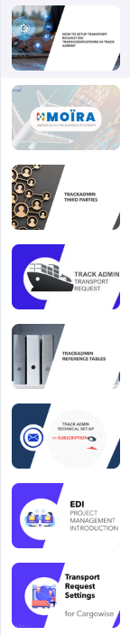
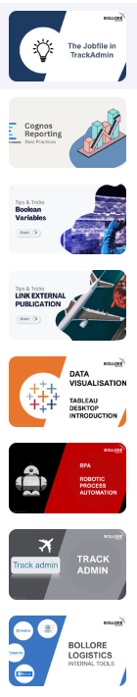





CUSTOMER BUSINESS SOLUTIONS
CONTINOUS LEARNING SOLUTION
SKILL UP
43 LEARNING MODULES AVAILABLE
CROSS CREATION AMONG I&S
ON DEMAND TRAINING
12 NEW MODULES ONGOING

Slide 12

CUSTOMER BUSINESS SOLUTIONS
TMS DEPLOYMENT
Bolloré Logistics office
Norway
Sweden
CBS MAIN MISSIONS
Denmark
GAP ANALYSIS & PROCESS DESIGN
EDI & REPORTING ADAPTATION
REQUESTS FOR SETTINGS
MDM PREPARATION*
United
Kingdom
Poland
The Netherlands
Germany
Czech Rep.
Belgium
Switzerland
France
Austria
Hungary
Italy
Romania
Spain
Portugal
COMING DEPLOYMENTS
SWEDEN : MAY 24
UNITED KINGDOM : APRIL 24
THE NETHERLANDS : SEPTEMBER 24
ITALY : OCTOBER 24
FR AIR IMPORT : APRIL 24
FR AIR EXPORT : MAY 24
FRENCH TERRITORIES : SEPTEMBER 24

Slide 13
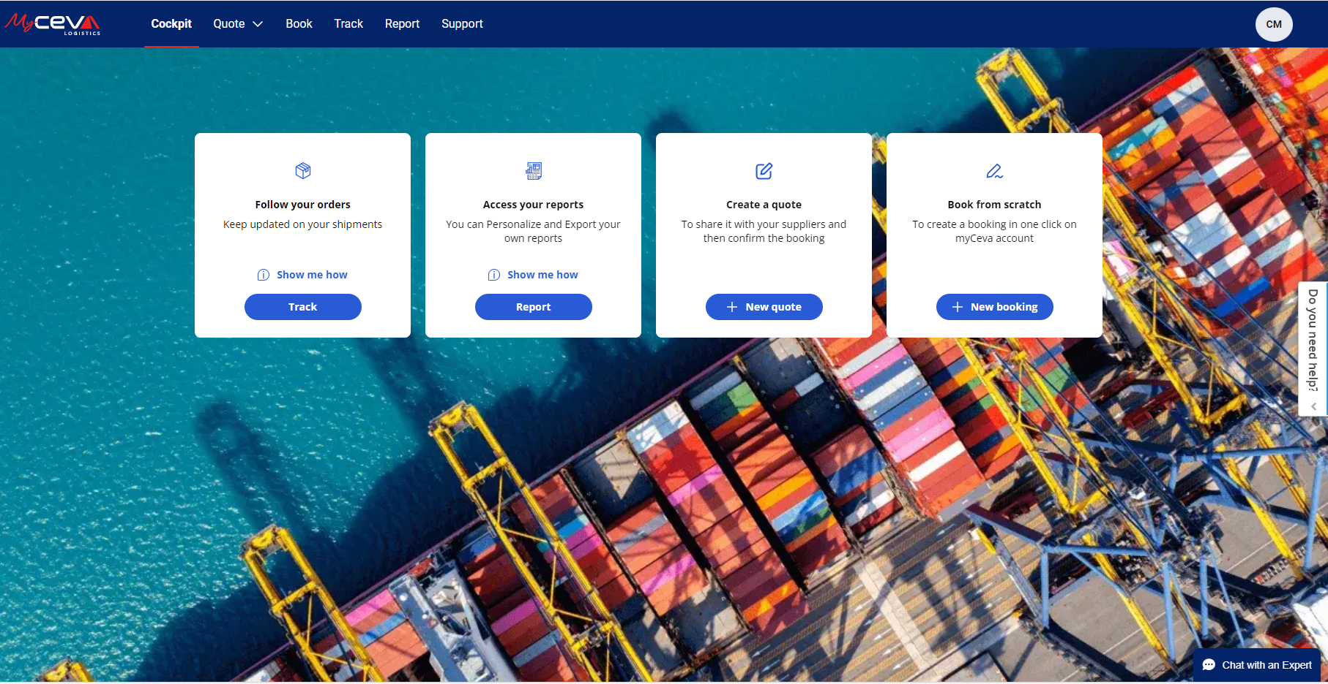
CUSTOMER BUSINESS SOLUTIONS
CUSTOMER PLATFORM - MYCEVA
POLARIS PROJECT FROZEN
STUDY & GAPS ANALYSIS SOON
ADVANCED TECHNOLOGY
UX & UI USER FRIENDLY
CUSTOMIZABLE SOLUTION
ROBUST IT ARCHITECHTURE
EASY TO PLUG&PLAY

Slide 14
IMPLEMENTATION & SOLUTIONS DEPT.
IMPLEMENTATION
IMPLEMENTATION
Global Project Management for startegic account
- New Customers
- New Awards for existing customer
Process reboot & optimization
Main Actions :
Sales Support, Planning Establishment, Project Coordination, Animation, Follow-up
CUSTOMER BUSINESS SOLUTIONS
Experts for IT Customer Solutions
- Project Management
- Sales supports
- Business View
Main Actions :
Solution Design, Specs, Test phasis, Training for EDI, Reporting, Track&trace and Web Platforms
BUSINESS INTELLIGENCE
Expertise in data ecosystem
Data governance
Data solutions
Community support
One Cockpit Europe Coordination
Main Actions :
Standard Report Offer, RFE, reports & solutions conception, knowledge sharing
CONTROL TOWER EMEA
Customer dedicated teams
Data Quality & Performance monitoring
Alert & Crisis management
Network animation
Business support
Main Actions :
Communication (SPOC), Monitoring, Improvement at regional Level
DIGITALIZATION
Robotic Process Automation
IDP
New technologies, Apps
New products, platforms (Winddle, P44, Wakeo, …)
Innovation = IA, Real Time Monitoring, predictivity
Main Actions :
Market Watch, Benchmark, Organize & Paricipate to MVP or POC, Promote Solution

Slide 15
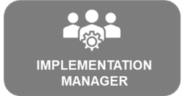
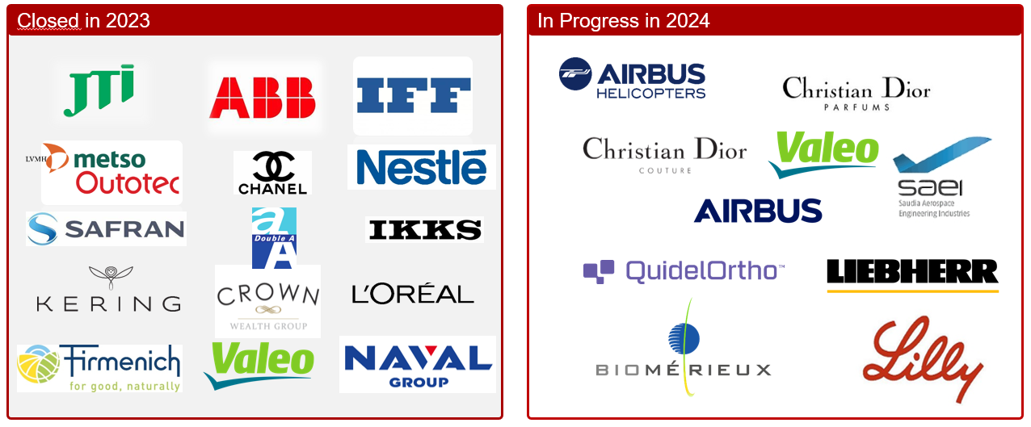
IMPLEMENTATION
PROJECTS OVERVIEW
IMPLEMENTATION

Slide 16
IMPLEMENTATION & SOLUTIONS DEPT.
BUSINESS INTELLIGENCE
IMPLEMENTATION
Global Project Management for startegic account
- New Customers
- New Awards for existing customer
Process reboot & optimization
Main Actions :
Sales Support, Planning Establishment, Project Coordination, Animation, Follow-up
CUSTOMER BUSINESS SOLUTIONS
Experts for IT Customer Solutions
- Project Management
- Sales supports
- Business View
Main Actions :
Solution Design, Specs, Test phasis, Training for EDI, Reporting, Track&trace and Web Platforms
BUSINESS INTELLIGENCE
Expertise in data ecosystem
Data governance
Data solutions
Community support
One Cockpit Europe Coordination
Main Actions :
Standard Report Offer, RFE, reports & solutions conception, knowledge sharing
CONTROL TOWER EMEA
Customer dedicated teams
Data Quality & Performance monitoring
Alert & Crisis management
Network animation
Business support
Main Actions :
Communication (SPOC), Monitoring, Improvement at regional Level
DIGITALIZATION
Robotic Process Automation
IDP
New technologies, Apps
New products, platforms (Winddle, P44, Wakeo, …)
Innovation = IA, Real Time Monitoring, predictivity
Main Actions :
Market Watch, Benchmark, Organize & Paricipate to MVP or POC, Promote Solution

Slide 17












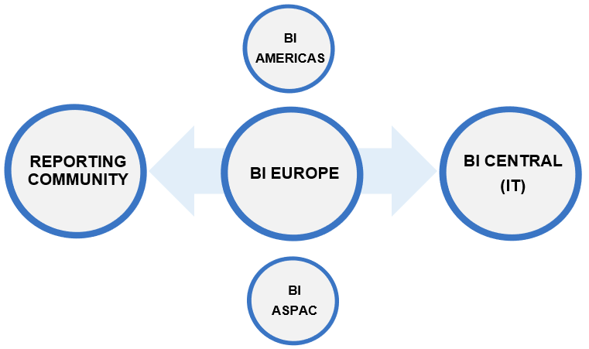


BUSINESS INTELLIGENCE
PROJECTS & ACTIVITIES
Projects
Governance
Expertise
Client reporting solutions
One Cockpit
Project governance
Client data ownership
Change management
Specification
Documentation
Knowledge sharing
Community awareness
E-learning
Community Support
Level 1 support & escalation point
Requests for evolutions (specification, UAT, release)
Middle Office KPI monitoring
Data Platform
Cognos/Tableau/PBI
Standard reports offer
Evolution arbitrage
Data integration / architecture / accessibility
User management
Platform organization
Data Quality
Ops Control Finance
Productivity
Metrics
Ops Excellence
17

Slide 18
IMPLEMENTATION & SOLUTIONS DEPT.
EUROPEAN CONTROL TOWER
IMPLEMENTATION
Global Project Management for startegic account
- New Customers
- New Awards for existing customer
Process reboot & optimization
Main Actions :
Sales Support, Planning Establishment, Project Coordination, Animation, Follow-up
CUSTOMER BUSINESS SOLUTIONS
Experts for IT Customer Solutions
- Project Management
- Sales supports
- Business View
Main Actions :
Solution Design, Specs, Test phasis, Training for EDI, Reporting, Track&trace and Web Platforms
BUSINESS INTELLIGENCE
Expertise in data ecosystem
Data governance
Data solutions
Community support
One Cockpit Europe Coordination
Main Actions :
Standard Report Offer, RFE, reports & solutions conception, knowledge sharing
CONTROL TOWER EMEA
Customer dedicated teams
Data Quality & Performance monitoring
Alert & Crisis management
Network animation
Business support
Main Actions :
Communication (SPOC), Monitoring, Improvement at regional Level
DIGITALIZATION
Robotic Process Automation
IDP
New technologies, Apps
New products, platforms (Winddle, P44, Wakeo, …)
Innovation = IA, Real Time Monitoring, predictivity
Main Actions :
Market Watch, Benchmark, Organize & Paricipate to MVP or POC, Promote Solution

Slide 19













EUROPEAN CONTROL TOWER
KEY ACCOUNTS & SCOPES OF WORK
CONTROL TOWER
GLOBAL ACCOUNTS, MULTI REGIONS TRANSPORT FLOWS, SENSITIVE CARGO, JUST IN TIME,DATA QUALITY
4PL POINT OF CONTACT, PERFOMANCE MANAGEMENT
PERFORMANCE MANAGEMENT
Data Quality monitoring
Performance & Deviation monitoring
Alert Management
REGIONAL NETWORK ANIMATION
KPIs & Continuous improvement
Support for new transport flows Implementation
Documentation management
CUSTOMER SUPPORT
Weekly calls / Sensitive flows & Hot shipments follow up
BUSINESS SUPPORT
Transport plan management
Business reviews (MBR, QBR)
PERFORMANCE MANAGEMENT
Data Quality monitoring
Deviation monitoring
Global shipment visibility
Alert Management
GLOBAL & REGIONAL NETWORK ANIMATION
Global processes
Worldwide data framework
Global KPIs Tableau update
Documentation management
4PL REFERENT
Global Customer reports
Invoice Audit follow up
PERFORMANCE MANAGEMENT
Data Quality monitoring
Deviation monitoring
Alert Management
GLOBAL & REGIONAL NETWORK ANIMATION
Global KPIs Tableau update
4PL REFERENT
Weekly Calls / Hot shipments monitoring
PERFORMANCE MANAGEMENT
Data Quality monitoring
Performance & Deviation monitoring
Alert Management
BUSINESS SUPPORT
Support to Sales for Invoice Audit follow up
uPERFORMANCE MANAGEMENT
Data Quality monitoring
Performance & Deviation monitoring
Alert Management
GLOBAL & REGIONAL NETWORK ANIMATION
KPIs & Continuous improvement
Documentation management
CUSTOMER SUPPORT
Weekly calls / Sensitive flows & Hot shipments follow up
BUSINESS SUPPORT
Business reviews (MBR, QBR)
PERFORMANCE MANAGEMENT
Data Quality monitoring
Deviation monitoring
Alert Management
GLOBAL & REGIONAL NETWORK ANIMATION
Business & Financial data Tableau update
BUSINESS SUPPORT
Business reviews (QBR)
PERFORMANCE MANAGEMENT
Data Quality monitoring
Performance & Deviation monitoring
Alert Management
4PL REFERENT
Invoice Audit follow up
Claims follow up
Weekly Calls / Hot shipments monitoring
PERFORMANCE MANAGEMENT
Data Quality monitoring
Performance & Deviation monitoring
Alert Management
CUSTOMER SUPPORT
Weekly calls / Sensitive flows & Hot shipments follow up
Global Control Tower

Slide 20
IMPLEMENTATION & SOLUTIONS DEPT.
DIGITAL TRANSFORMATION
IMPLEMENTATION
Global Project Management for startegic account
- New Customers
- New Awards for existing customer
Process reboot & optimization
Main Actions :
Sales Support, Planning Establishment, Project Coordination, Animation, Follow-up
CUSTOMER BUSINESS SOLUTIONS
Experts for IT Customer Solutions
- Project Management
- Sales supports
- Business View
Main Actions :
Solution Design, Specs, Test phasis, Training for EDI, Reporting, Track&trace and Web Platforms
BUSINESS INTELLIGENCE
Expertise in data ecosystem
Data governance
Data solutions
Community support
One Cockpit Europe Coordination
Main Actions :
Standard Report Offer, RFE, reports & solutions conception, knowledge sharing
CONTROL TOWER EMEA
Customer dedicated teams
Data Quality & Performance monitoring
Alert & Crisis management
Network animation
Business support
Main Actions :
Communication (SPOC), Monitoring, Improvement at regional Level
DIGITALIZATION
Robotic Process Automation
IDP
New technologies, Apps
New products, platforms (Winddle, P44, Wakeo, …)
Innovation = IA, Real Time Monitoring, predictivity
Main Actions :
Market Watch, Benchmark, Organize & Paricipate to MVP or POC, Promote Solution

Slide 21



DIGITAL TRANSFORMATION
GLOBAL TRANSFORMATION OFFER [2023]
Process
Users
UIPATH
ARCHITECTURE
NO GO
PRODUCTION
PENDING
65
GLOBAL AUTOMATION
OFFER
1
Dedicated Environment
Center of Excellence
TO START
IN PROGRESS
4
PROMOTE
OFFER TO BUSINESS
+ 41
vs 2022
Partners
Notes:
BRAINWARE >

Slide 22
DIGITAL TRANSFORMATION
MAJOR PROCESSES OPERATED BY BOTS
DATAQUALITY BOTS
BUSINESS BOTS
CUSTOM BOTS
DIOR WHS MANAGEMENT / BL CDG
HS CODE MAPPING / BL CDG
EASYBOT / GLOBAL ACCOUNT
NESTLE CARGOO / BL MARSEILLE
GIVAUDAN / BL SWITZERLAND
RPA BALANCE FINANCIAL / BL PUTEAUX
2024 UPCOMING BOTS
SCHNEIDER / BL LYON
LIEBHERR INVOICING PROCESS / BL TOULOUSE
AIRBUS / BL CT
CW1 INVOICING PROCESS / GLOBAL
BOTS VIA EXTERNAL SERVICE
TOM MNGMT / GLOBAL
LOREAL / BL LEHAVRE
CURIUM / BL ROISSY
INVOICE MNGMT / BL POLAND
BOARDING CONFIRMATION / BL ROISSY
FINANCIAL PROCESS / BL GERMANY
FINANCIAL BOTS
HANDLERS (MILESTONE) / BL ROISSY
ECS TRANSMISSION / BL MARSEILLE
AIRBUS FHS / BL TOULOUSE
MAISONS DU MONDE / BL MARSEILLE
CUSTOM WATCH / BL FRANCE
C03 MERCURE REPORT / BL ITALY
SCHNEIDER / BL ROISSY
IOT DEVICES PAIRING / BL CDG
INVOICE MANAGEMENT / BL ITALY
EXPORT HLA / BL ROISSY
SYSTEM U / CUSTOM DEPARTEMENT
RPA BALANCE FINANCIAL / BL PUTEAUX
REF MANAGEMENT / BL ROISSY
HR MNGMT / BL MARSEILLE
LIEBHERR INVOICING PROCESS / BL TOULOUSE
SYSTEM U / CUSTOM DEPARTEMENT
ROLEX TR / BL SWIZERLAND
Notes:
BRAINWARE >

Slide 23


















DIGITAL TRANSFORMATION
BENCHMARK & NEW DIGITAL SOLUTIONS
SOLUTION | Contract | EDI | POC | CLIENT POC | RetEx | Implementation
 | Managed by Corp. | Managed by Corp. |  |  |  | GIVAUDAN | BIOMERIEUX | EXPANSCIENCE | IBECOR
 |  |  |  |  | Mar.24 (T&T) Oct.24 (Booking) | LOREAL T&R | SODIAAL | VALSPAR |NUTRISET | FAUREVIA
 |  |  |  |  |  | CHANEL | LOREAL | TIFFANY & CO | MDM | LV | HERMES | ERAM | JJA | SLN | VETIR
Predictive Cockpit
 |  |  |  | France |  | Germany, Italie, China > Done
 |  |  |  |  |  | Under analysis:
 |  |  |  | Europe |  | Access opened for AME, APAC and MESA
Project standby > waiting CEVA synergies > BEACONE
Notes:
P44 : Tracking air/sea au container ou LTA
WAKEO : tracking Container
WINDDLE : PO MGT
TNP : predictive
QUOTE ME : Online Quotation
LOUXOR : Etiquetage

Slide 24

CMA CGM GROUP LOGISTICS DIVISION

